Slide 1

How Hackers Undergo Reconnaissance
By Kelvin (w0rmhol3)

Slide 2

What Is Reconnaissance Attack?
A reconnaissance attack is a process whereby a hacker plays the role of an undercover detective to fish for information about their target and then use that information to identify vulnerabilities ahead of their attacks.

Slide 3

SO WHAT DOES HACKERS ACTUALLY LOOK FOR IN THIS PHASE?

Slide 4

Finding Out:
The Target’s Personal Information
Identity
Social Media
etc
The Target Systems’ Information
Device Operating System
Open ports
etc

Slide 5

OSINT to Gather Target’s Info

Slide 6



Slide 7

What is OSINT?
Open Source INTelligent
Search for the target’s publicly available sources
Completely Legal

Slide 8

Top Used OSINT Tools
Sherlock
Maltego
Shodan
Recon-Ng

Slide 9
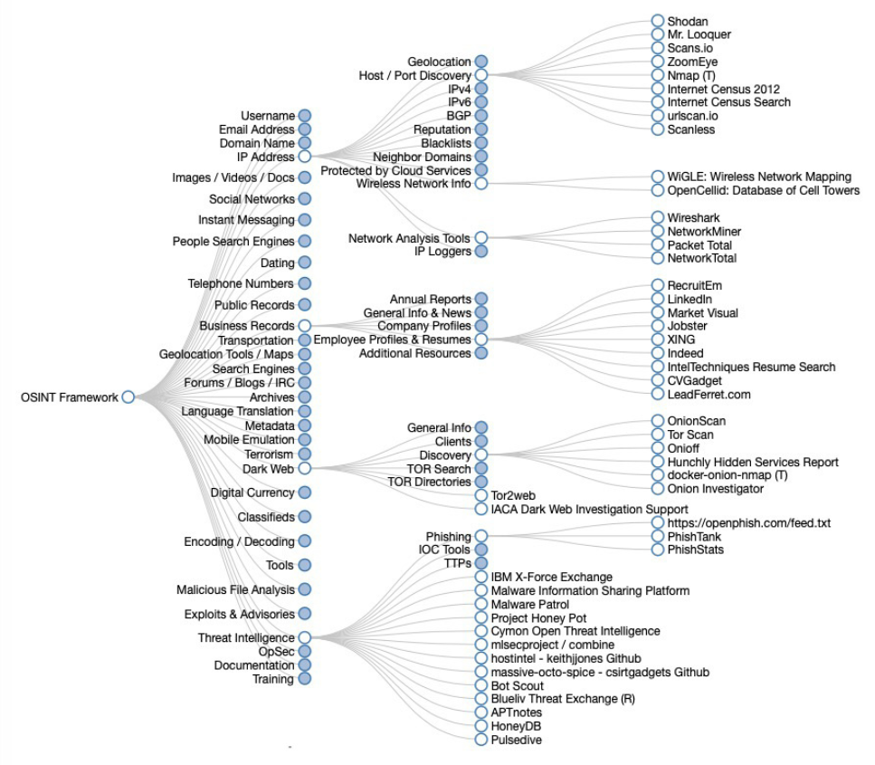
Source: osintframework.com

Slide 10

Disclaimer
Kids, don’t start doing illegal stuff thanks, I will whack u if u abuse what I share to u🙂

Slide 11
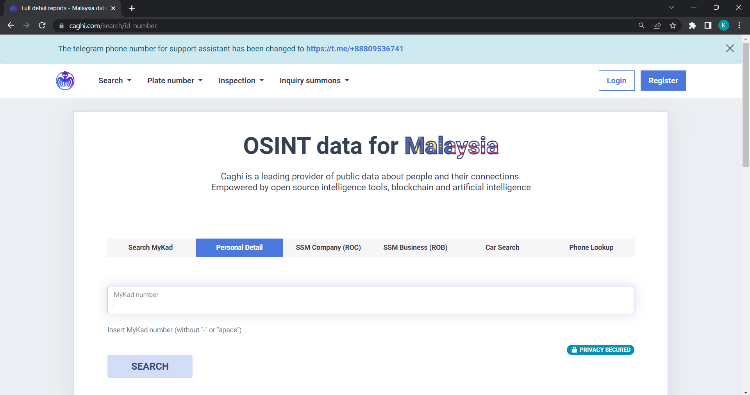

Slide 12

Google OSINT aka Google Dorking
Abusing Google search engine by injecting queries
Find information inaccessible through regular google searching
https://www.exploit-db.com/google-hacking-database

Slide 13

So, How to Avoid It?
Think before you post
Clear social media footprints
Remove old post
Delete unused account
The lesser you share, the more secured you are

Slide 14

Social Engineering
I talk with u, u talk with me?

Slide 15

Textbook: Hackers uses tactics to manipulate, deceive, and influence the thoughts of their target in order to retain critical information
In short: psychological manipulation
Comes in different forms

Slide 16

Phishing Attack
Where’s the fish?*
A Game of Scam

Slide 17
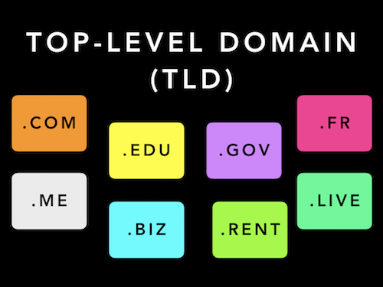

Slide 18

Spot the phishing link:
https://github.com/kubernetes/kubernetes/archive/refs/tags/v1.27.1.zip
https://github.com∕kubernetes∕kubernetes∕archive∕refs∕tags∕@v1271.zip

Slide 19
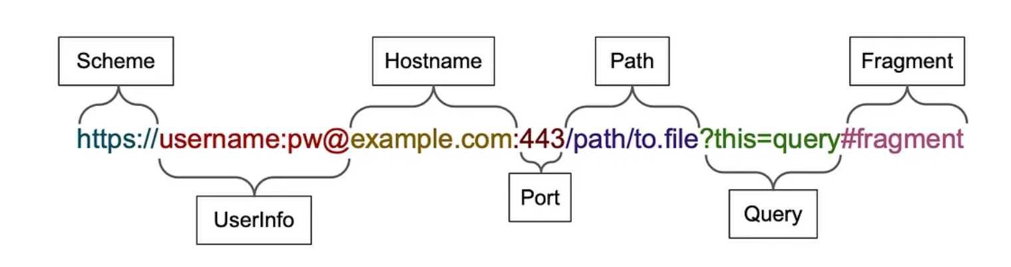
The “@” operator phishing trick

Slide 20

www.facebook.com@instagram.com

Slide 21
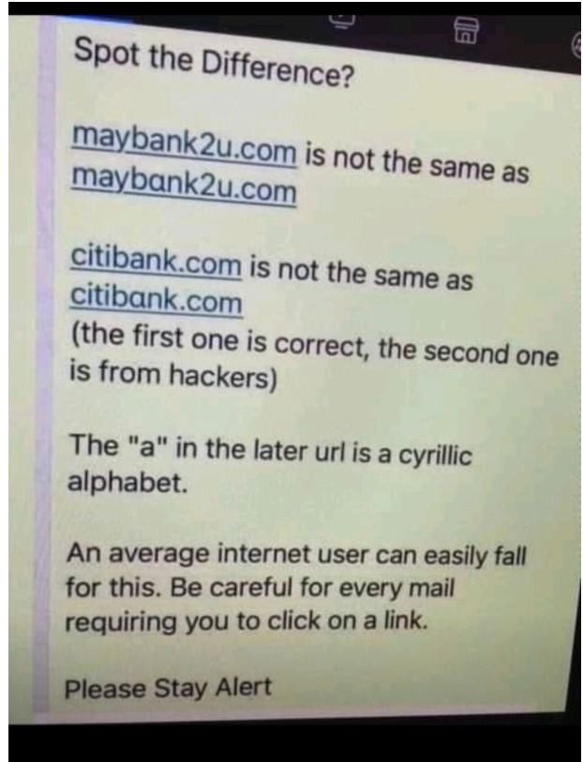
Unicode Phishing Link

Slide 22
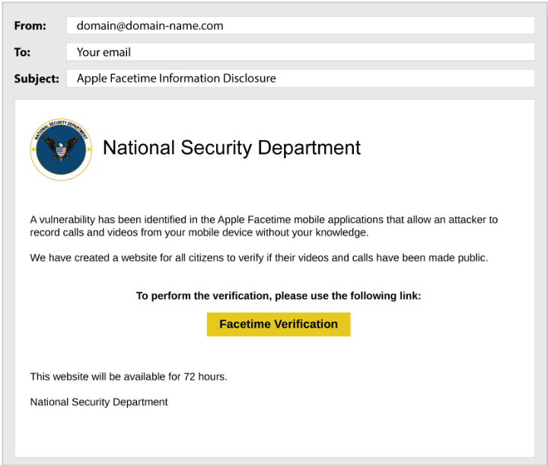
Email Phishing

Slide 23
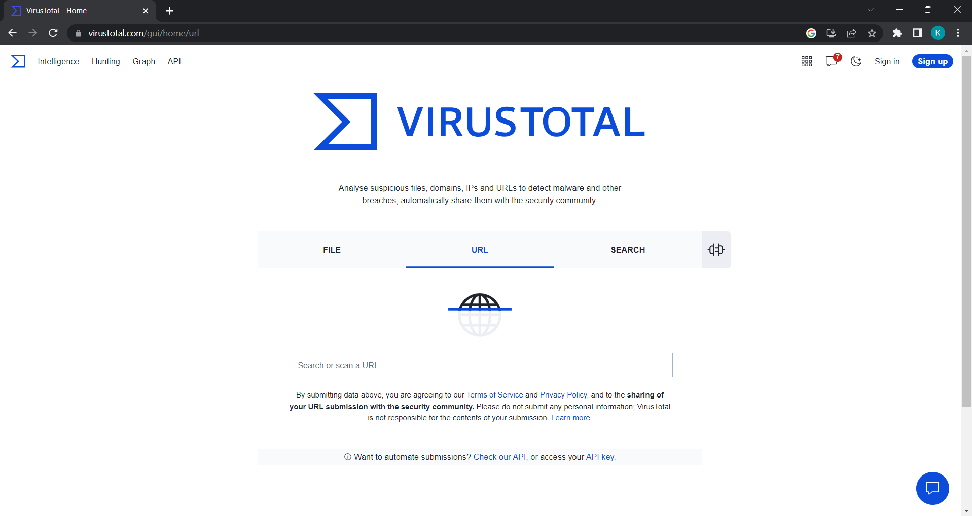
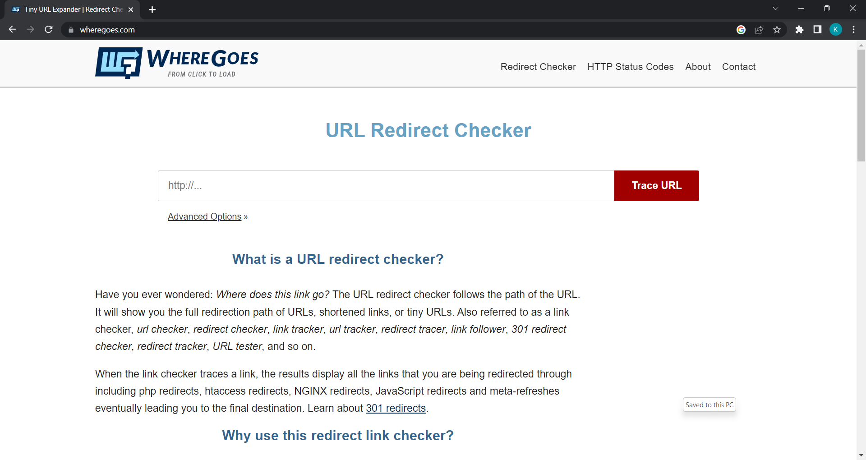
https://www.virustotal.com
https://wheregoes.com/

Slide 24

Physical Social Engineering
Direct approach of human interaction with the target (individual/organization)
Convincing the target to admit control over certain information by planting a conversation starter that will attract the interest of the target

Slide 25
Reasons Physical Social Engineering Occurs
Hackers may found the weakest link within an organization.
Gained certain trust on that person.
Intent to manipulate a person into becoming an organization’s inside threat.

Slide 26


Q&A or Go Home

